Slide 1
I-5/Yesler Way to Northgate Way Vic. Pavement, Deck, Joints, and Drainage Project
Curt Winningham, PE
April 18th, 2024

Slide 2
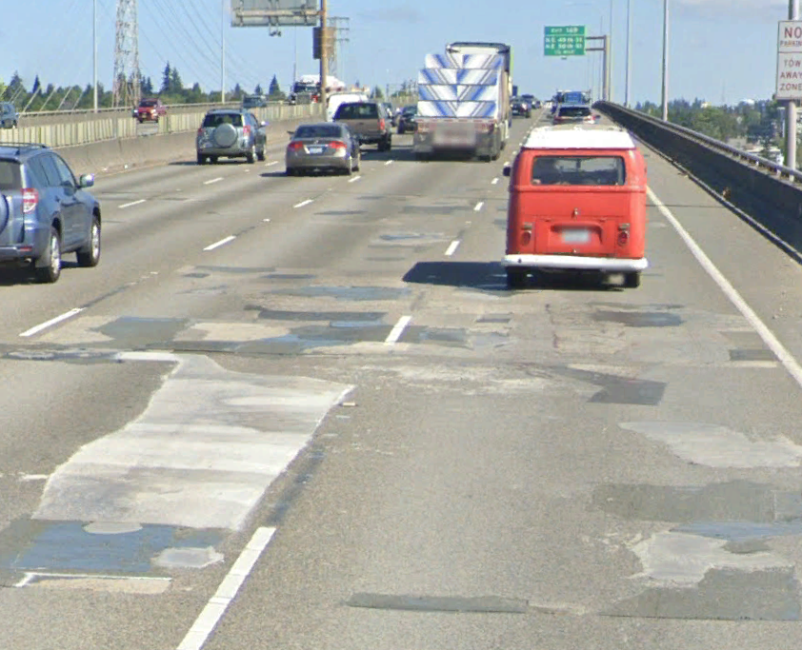
Reason for Project
60-year-old freeway
Too many emergency repairs

Slide 3
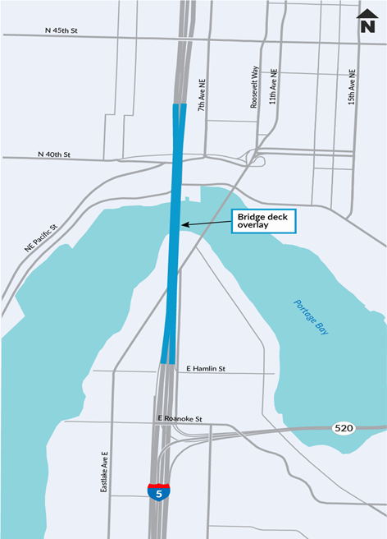
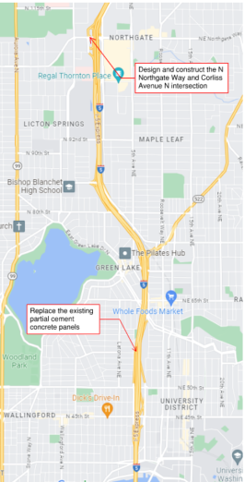
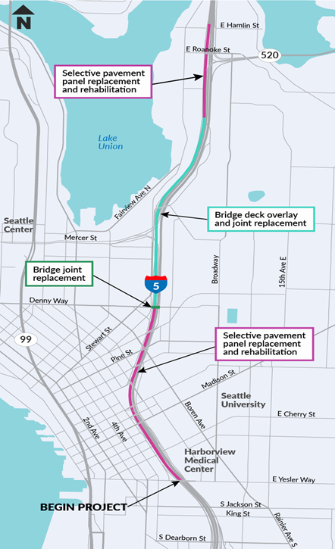
Project Locations:
Location A:
I-5 SB Yesler Way to Ship Canal Bridge
Location B:
I-5 NB/SB
Ship Canal Bridge
Location C:
I-5 NB/SB Ship Canal to Northgate Vic.

Slide 4

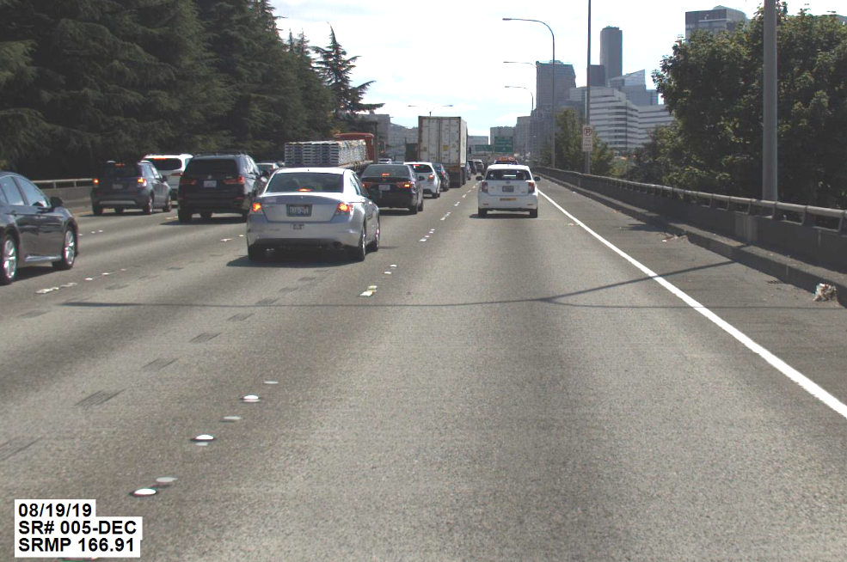
Location A: I-5 SB, Yesler Way to Ship Canal
Yesler Way to Ship Canal Bridge
  Replace or repair selective concrete panels
Denny Way Over I-5
  Expansion joint rehabilitation
Lakeview Viaduct
  Replace bridge deck overlay
  Replace existing expansion joints
Resurface ten I-5 on- and off-ramps paving with HMA.

Slide 5

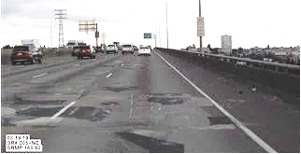
Location B: Ship Canal
Bridge NB & SB
Ship Canal Bridge
Replace the existing Latex-Modified Concrete (LMC) overlay
Perform deck repair underneath on both upper and lower deck
Replace/repair the existing transverse/ longitudinal joint seals and expansion joints
Replace existing bridge drain scuppers and downspout pipes.

Slide 6
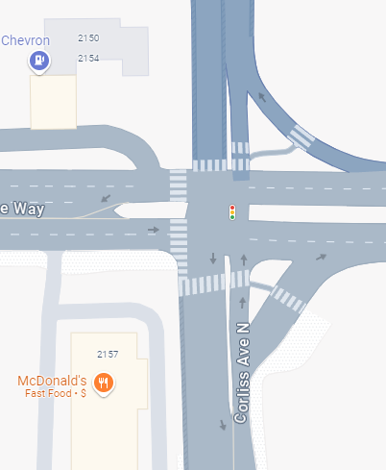
Location C: Ship Canal
Bridge to Northgate
Northgate Way & Corliss Ave. N.
Re-construct the intersection to make it more pedestrian-friendly
Ravenna to SB I-5
Remove the broken concrete sliver in the left lane and replace with asphalt
Resurface 18 ramps

Slide 7
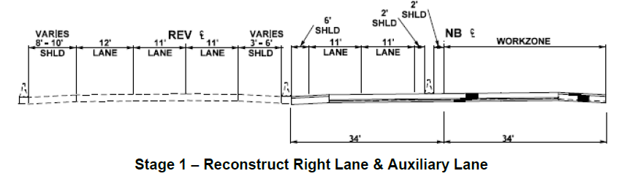
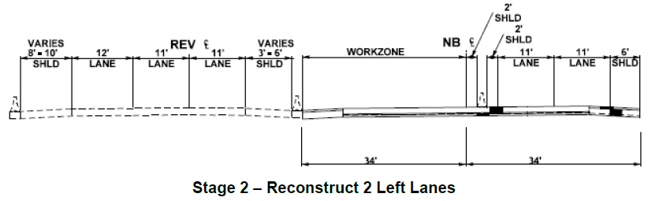
MOT Strategy
Linear Long-Term Closures
Duration dependent on length of work zone
Typically two stages of work
Mainline lanes
  2 lanes closed (typical)
  2 lanes open (typical)
Work occurs behind
temporary concrete barrier
Work occurs 24 hours/day
(subject to noise variance)
Detours to Express Lanes
and other regional routes
Typical allowable closures
Overnight closures
Weekend-long closures
REVERSIBLE
EXPRESS LANES
NB MAINLINE
REVERSIBLE
EXPRESS LANES
NB MAINLINE

Slide 8
Design-Build Information
Procurement
  RFP includes 30% design and project requirements
  No prescribed order of work
  Alternative Technical Concepts (ATCs)
  Apparent Best Value
Included in RFP
  No long-term linear lane closures before January 2025
  No long-term linear lane closures during 2026 World Cup
Once project is awarded
  Design and construction occurs concurrently in increments
  WSDOT team will continue to provide updates to partners

Slide 9
Procurement Schedule
RFQ Ad | July 17, 2023
SOQs Due | August 31, 2023
Notify Shortlisted Submitters | October 17, 2023
Issue RFP | October 26, 2023
Proposals Due | February 21, 2024
Announce Best Value Proposer | April 17, 2024
Estimated Notice to Proceed | May 16, 2024
Substantial Completion date in RFP | December 31, 2027

Slide 10
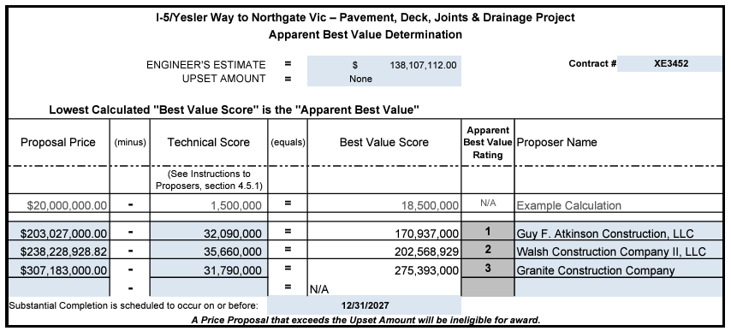
Apparent Best Value

Slide 11

Questions

